Slide 1
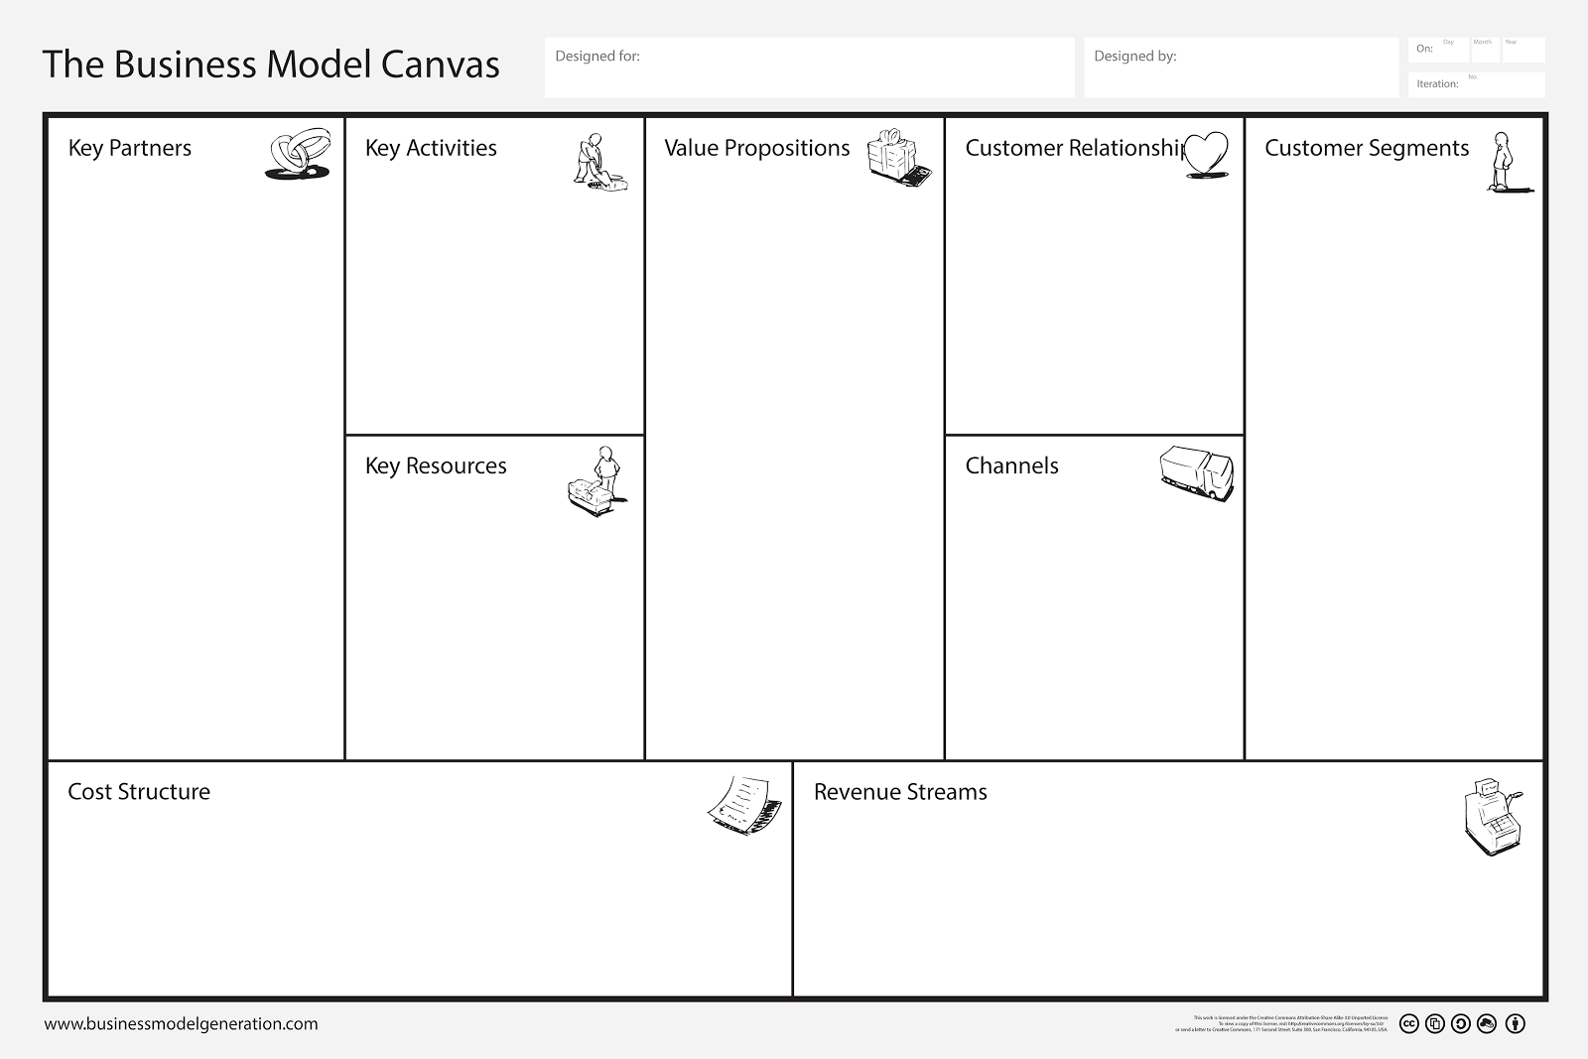
Partner 1
Partner 2
Partner 3
…
Activity 1
Activity 2
Activity 3
…
Proposition 1
Proposition 2
Proposition 3
…
Relationship 1
Relationship 2
Relationship 3
…
Segment 1
Segment 2
Segment 3
…
Resource 1
Resource 2
Resource 3
…
Channel 1
Channel 2
Channel 3
…
Cost 1
Cost 2
Cost 3
…
Stream 1
Stream 2
Stream 3
…

